Slide 1
GG OFTO Investor Presentation December 2023

Slide 2
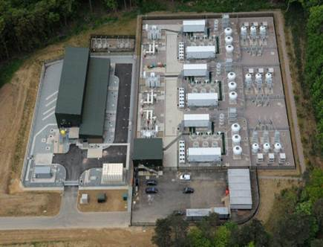
Welcome
Tenth Investor Presentation by Greater Gabbard OFTO (GG OFTO) plc to Bondholders
Format - there will be a short presentation followed by a question and answer session
The following OFTO representatives are present:
General Manager / Operations Manager | Roger Morgan, Cameron Waite
OFTO Directors | Ben Burgess, Jemma Sherman
Finance Manager | Shyam Popat
Security and Bond Trustee Bishopsfield Capital | Deutsche Bank OFTO Advisor

Slide 3
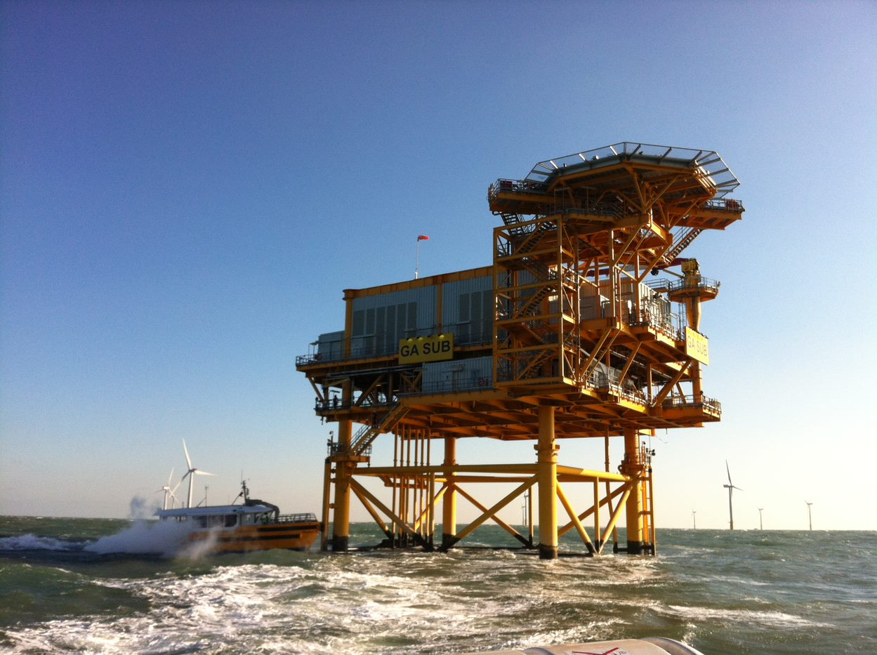
Contents
Welcome | 2
Contents | 3
GG OFTO Project Information | 4
Summary | 5
Key Points | 6
Key Financial Performance | 7
Questions and Answers | 8

Slide 4
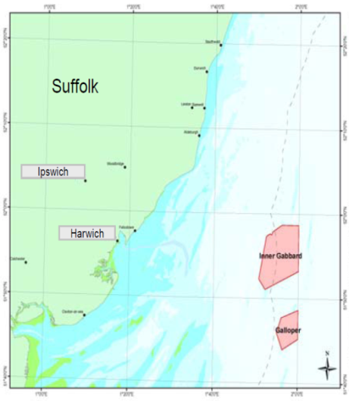
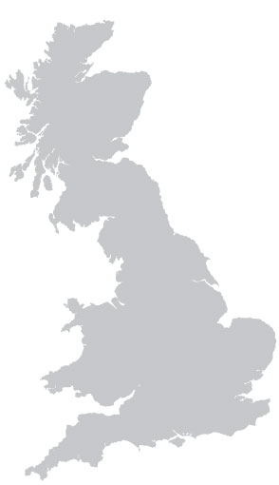
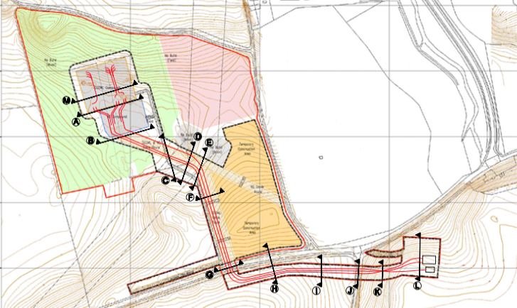
GG OFTO Project Information
The Greater Gabbard offshore wind farm (504MW) is located off the Suffolk coast approximately 40km east of Harwich in the Thames Estuary.
The OFTO owns two offshore platforms and three export cables that make landfall in Sizewell.
Suffolk
Ipswich
Harwich
Inner Gabbard
Galloper
The onshore cables connect to the Greater Gabbard Leiston substation compound
From the compound the circuits connect into the adjacent National Grid Substation

Slide 5
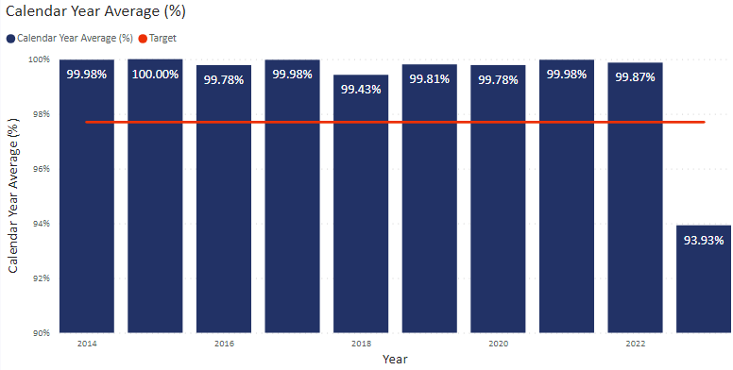
Operations Summary
Health and Safety | Zero H&S RIDDORs/reportable incidents The OFTO reviews H&S through monthly reports and a quarterly H&S forums to hold the O&M Operator to account A H&S audit of the O&M Operator’s Operations and procedures (Offshore and Onshore) has been planned for 2024
OFTO Lifetime Availability to 2023 (99.25%) Calendar year 2023 (93.93%)
Maintenance / outages | The OFTO experienced two unplanned outages in January and February 23 that impacted availability, these related to a busduct and an offshore transformer fault Both faults resulted in a loss of a circuit and were successfully repaired by the Operator The OFTO has submitted two exceptional event claims to Ofgem to recover lost availability. The OFTO remains confident that these claims will be approved which would push the OFTO’s availability for 2023 to close to 100% Following a cable theft (stolen copper) at the Leiston onshore substation the OFTO has increased security with improved CCTV coverage and an electric fence, following these upgrades no attempted break-ins have been reported All planned maintenance is upto date and has been completed by the O&M Operator
Insurance | No insurance claims were raised during 2023 – regular engagement has taken place with insurers Insurance has been renewed in November 2023 which was part of a two year Long Term Agreement

Slide 6
Project Key Points
Issue | Update
OFTO Compliance | The OFTO has complied with its licence obligations, including the provision of regulatory accounts/audit and quarterly availability reporting to Ofgem Semi-annual Lender Investor reports have been completed in conjunction with the Lenders TA and posted onto the GG OFTO website A successful OFTO licence compliance audit was completed in Summer 2023
Fibre Failures | No change to status of broken fibres in the nearshore subsea section - situation remains stable Interconnector cable between the two Offshore Platforms has broken fibre failures and remains unchanged. The OFTO installed a highly reliable microwave link that has facilitated equipment communications across the two platforms Fibres are tested monthly and will continue to do so in 2024
Freespanning cables | There has been no material change to the freespans in the nearshore region, however, evidence suggests that the freespans are migrating which is due to them being located in a dynamic section of seabed that is constantly moving Initial assessment of vibration due to water flow around the freespans confirmed that the freespans require constant monitoring and that remediation (placing rock bags) would not resolve the issue due to constant migration The agreement with fishermen to not fish in this region remains in place, and the risk to the cable remains low
Two unplanned outages in Jan and Feb 23 | In Jan 23 a failure of a section of busduct located Offshore caused a single circuit outage lasting 18 days – this was repaired by the O&M contractor Works to mitigate the risk of a repeat failure have been undertaken with the support of the Original Equipment Manufacturer, further works are planned in 2024 to improve the system resilience In February a failure of a component within an Offshore transformer caused a single circuit outage lasting 40 days – repaired by Operator Root cause analysis identified the potential for the fault to be present in two identical transformers located Offshore. Transformer gas analysis indicated that a similar fault was occurring in one transformer so the equipment was replaced. After testing the other Transformer didn’t indicate any issues so there was no need to replace the kit – this will be kept as a strategic spare by the OFTO and OFTO will continue to monitor.

Slide 7
Key Financial Performance
Transmission Revenue has been invoiced and received within the agreed time limits
Proposed revenue for 23/24 is £37m
Monitored Operating Costs : actual year to September 2023 £2,617k – within the 80% - 120% threshold tests
Payments to key contractors have been made as per contracts
Key financial deliverables have been met, including the filing of regulatory accounts for the period ended 31 March 2023 with the Authority
The Financial and Compliance Audits were signed off in July 2023 by MHA MacIntyre Hudson and Henderson Loggie LLP respectively. The Financial Statements and the Annual Compliance Report were distributed to the Lenders via upload to the Bondholders website.
Bond interest and principal were paid in full according to the payment schedule in March 2023 (£12.1m) and September 2023 (£12.2m)
All reserve accounts remain fully funded
 | Ratio | Lock up Level
Projected DSCR | 1.25 | 1.10
Historic DSCR | 1.21 | 1.10
Debt Life Cover Ratio | 1.44 | 1.15

Slide 8
Questions & Answers
Thank You

Slide 10
December 2023

