Slide 1
GG OFTO Investor Presentation
December 2024

Slide 2
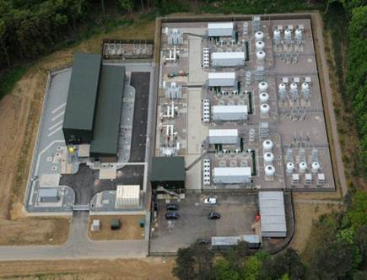
Welcome
Eleventh Investor Presentation by Greater Gabbard OFTO (GG OFTO) plc to Bondholders
Format - there will be a short presentation followed by a question and answer session
The following OFTO representatives are present:
General Manager / Operations Manager | Roger Morgan, Simon Boddison
OFTO Directors | Jemma Sherman, Tarkan Pulur
Finance team | Tanisha Mann
Security and Bond Trustees Bishopsfield Capital | Adam Wilson Arthur Moerman and Aukje Voskamp (BCP)

Slide 3
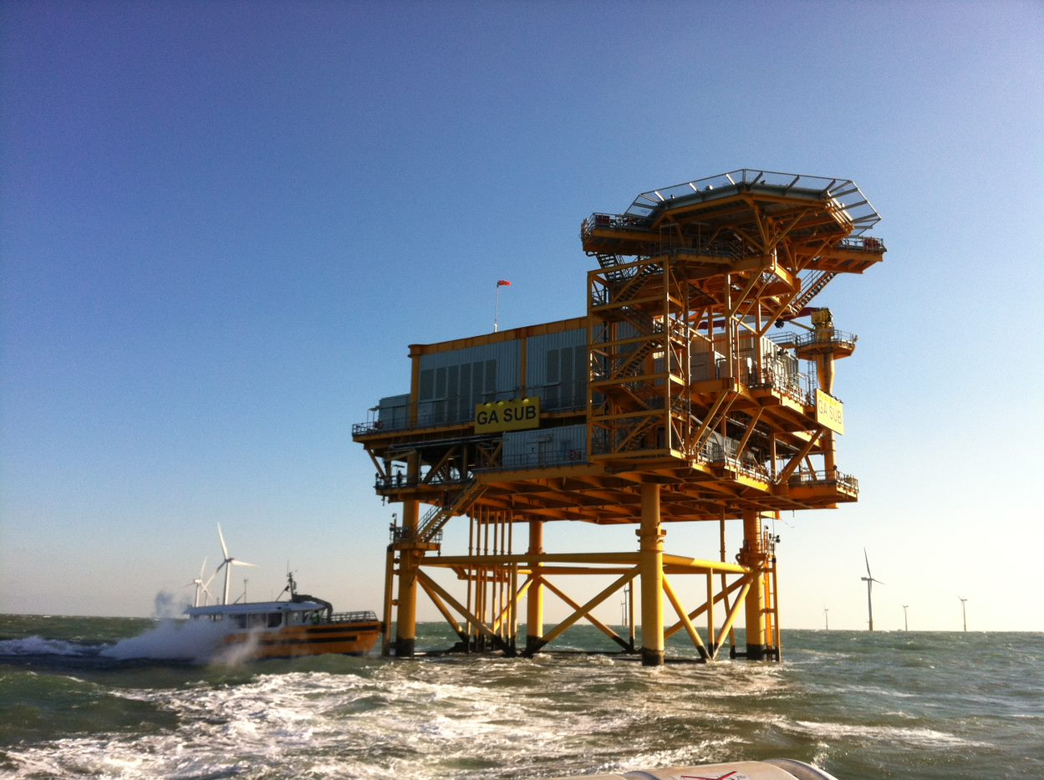
Contents
Welcome | 2
Contents | 3
GGOFTO Project Information | 4
Summary | 5
Operations Update | 6&7
Key Financial Performance | 8
Questions and Answers | 9

Slide 4
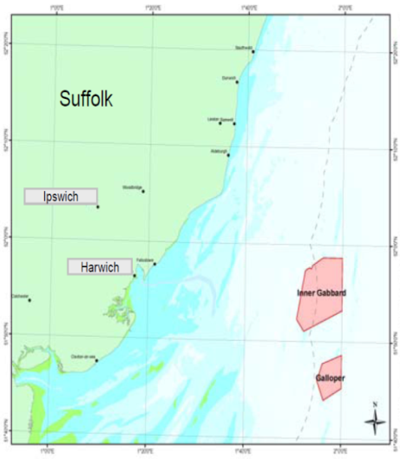
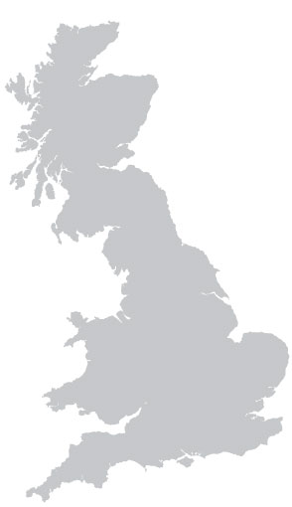

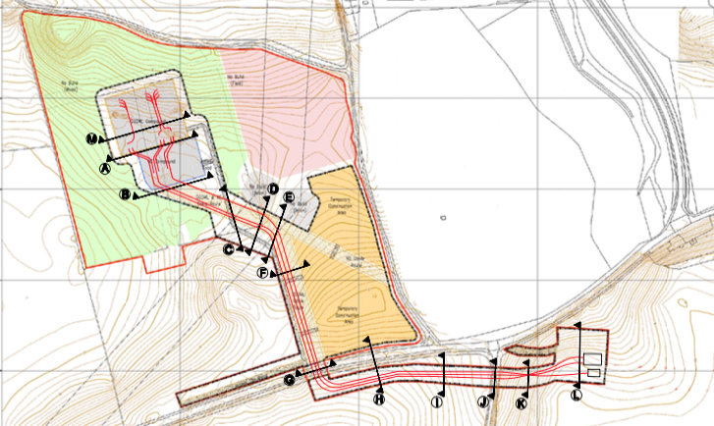
GG OFTO Project Information
The Greater Gabbard offshore wind farm (504MW) is located off the Suffolk coast approximately 40km east of Harwich in the Thames Estuary.
The OFTO owns two offshore platforms and three export cables that terminate onshore at Sizewell.
Suffolk
Ipswich
Harwich
Inner Gabbard
Galloper
The onshore cables terminate in the Greater Gabbard Leiston substation compound for switching, monitoring and power quality compensation.
From the compound the interconnect circuits run into the adjacent National Grid substation.

Slide 5
Summary
Health and Safety | No Health and Safety (H&S) incidents to report since the last presentation, zero RIDDORs The OFTO has established a quarterly H&S forum to hold the O&M Operator (EDS HV Ltd) to account A H&S audit of EDS’s Operations offshore has recently been completed and some corrective actions are being taken
Availability – 2014 to 2024 Exceptional Event Claims | Lifetime Availability is 99.31% Availability for 2024 is 98.80% The took a planned outage in September 2024 to replace sections of faulty busduct equipment – the OFTO intends to reclaim the lost availability through an Exceptional Event Claims The OFTO is expecting lifetime availability to be even higher after Ofgem accepted one Exceptional Event claims for lost availability and is minded to accept the other’: The claims relate to two unplanned outages in 2023 a busduct fault and a transformer diverter insert fault
OFTO Compliance | The OFTO has complied with its licence obligations, including the provision of quarterly availability reporting to Ofgem Semi annual investor reports have been loaded onto the GG OFTO website A successful compliance audit was completed in Summer 2024
Insurance | No insurance claims raised during 2024 – regular engagement has taken place with insurers the OFTO recently placed insurance and was able to make savings on premiums for Property Insurance the OFTO successfully placed insurance for terrorism and liability

Slide 6
Operations Update
Issue | Update
Maintenance | 2024 has been a successful year Assets are subject to an ongoing risk assessment (based on maintenance activities) that will inform planned and preventative maintenance for 2025 and beyond EDS is paying particular attention to critical assets that may impact on OFTO availability and on planned preventative maintenance and asset risk assessments Planned maintenance is slightly behind schedule. Poor weather has been encountered throughout the year and EDS have also been supporting the windfarm generator with a large reactive switchgear replacement campaign following a failure. EDS intend to push forward in the new year to catch-up
Fibre Failures – Contingency Planning | No change to status of fibres in the nearshore subsea section Interconnector cable between the two Offshore Platforms contains a fibre link - these fibres have failed resulting in a loss of communication between the two Offshore Platforms Communication has been maintained by installing a highly reliable microwave link that transmits information between both Offshore Platforms Cable repair framework agreements are in place and cable repair scopes are in place for the interconnector and nearshore and are ready to be issued if necessary Spare joints are in storage as well as various other spares required for an offshore cable repair The OFTO has procured a replacement cable monitoring system to inform operational decisions around cable usage
Freespanning cables | Sections of cable in the nearshore area have been identified as free spanning: Fishermen have agreed not to fish in the local area and compensation arrangements have been agreed The OFTO has completed a subsea survey in September 2024 in the nearshore area which shows that the freespans are migrating and risk assessment has confirmed that there’s a small risk of anchor drag or third party interference (fishing) The nearshore area where the freespans are located is a dynamic and changing environment that is subject to shifting seabed movement which makes remedial works extremely challenging – due to this the OFTO is not planning to undertake remedial works and is establishing a robust monitoring regime – which may involve more frequent surveys and analysis on potential for cable fatigue
 | It is anticipated that all work will be carried out using operating cash flow whilst maintaining reserve accounts at contracted levels

Slide 7
Operations Update (cont)
Issue | Update
IG-SUB Heila Crane | The Heila knuckleboom crane on the Inner Gabbard Offshore Platform failed inspection EDS have sourced a replacement crane which is on the Platform awaiting installation. The existing crane has been stripped but poor weather has delayed the installation of the replacement crane. Due for completion by end of January 2025 Replacement crane and all labour is the cost responsibility of EDS, no costs incurred to the OFTO
IG-SUB Module 3 Busduct | Module 3 33kV busducts were replaced by EDS and the OEM Mosser Glaser successfully in August/September 2024 During testing, an issue was found with the Wind Farm Generator GGOWL 33kV switchgear termination EDS assisted GGOWL during their fault identification works, which resulted in the 33kV switchgear being condemned EDS continue to support GGOWL during the ongoing switchgear replacement, recommissioning works and circuit return to service (re-energisation)
Leiston – Copper Theft | Following a break in and the theft of copper earth tape, an electric fence has been installed around the site and the site CCTV upgraded Final commissioning of the remaining section of fencing for the 132kV CVT compound will be completed in December 2024 Electic fencing covering all the other compounds is fully operational The site CCTV system has been upgraded and is fully operational
Leiston - Automatic Voltage Regulators (AVRs) | The three AVRs have encountered several failures during 2024 with the OEM Sollatek attending site to carryout repairs The OFTO has secured a set of strategic spares as a short to mid-term strategy as original spare parts are becoming sparce due to their obsolescence EDS and the OEM Sollatek are working on a long-term solution to replace one of the existing AVRs with a new, modern unit, allowing the remaining two original units to become back-ups and the replaced unit as donor parts
 | It is anticipated that all work will be carried out using operating cash flow whilst maintaining reserve accounts at contracted levels

Slide 8
Key Financial Performance
Transmission Revenue has been invoiced and received within the agreed time limits
Proposed revenue for 24/25 is £39m
Monitored Operating Costs : actual year to September 2024 £2,257k – within the 80% - 120% threshold tests
Payments to key contractors have been made as per contracts
Key financial deliverables have been met, including the filing of regulatory accounts for the period ended 31 March 2024 with the Authority
The Financial and Compliance Audits were signed off in July 2024 by MHA MacIntyre Hudson and Henderson Loggie LLP respectively. The Financial Statements and the Annual Compliance Report were distributed to the Lenders via upload to the Bondholders website.
Bond interest and principal were paid in full according to the payment schedule in March 2024 (£11.3m) and September 2024 (£11.9m)
All reserve accounts remain fully funded.
 | Ratio | Lock up Level
Projected DSCR | 1.35 | 1.10
Historic DSCR | 1.24 | 1.10
Debt Life Cover Ratio | 1.54 | 1.15

Slide 9
Questions & Answers
Thank You

Slide 11
December 2024

